Slide 1


IoT Communication Network
A computer network of tiny computers
Mid Presentation
By :
Ali Swade
Suray Swade
Supervisor :
Roy Mitrany

Slide 2
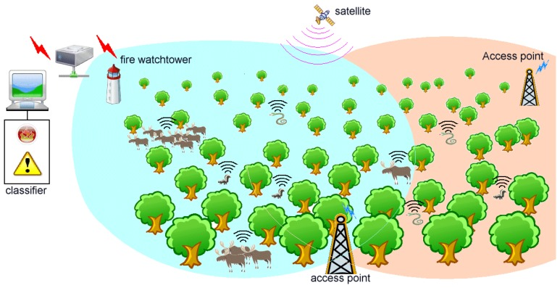
Motivation
Forest Fire detection systems face many obstacles:
Networking
Expensive Systems
Covering large areas

Slide 3

Project Goals
Establish communication between tiny computers without access point
Setting up a server that communicates with the tiny computers Network
Minimal requirements :
Cheap
Efficiency

Slide 4
Potential Solution
esp32 cam
painlessMesh Library
Mesh
Json foramt

Slide 5
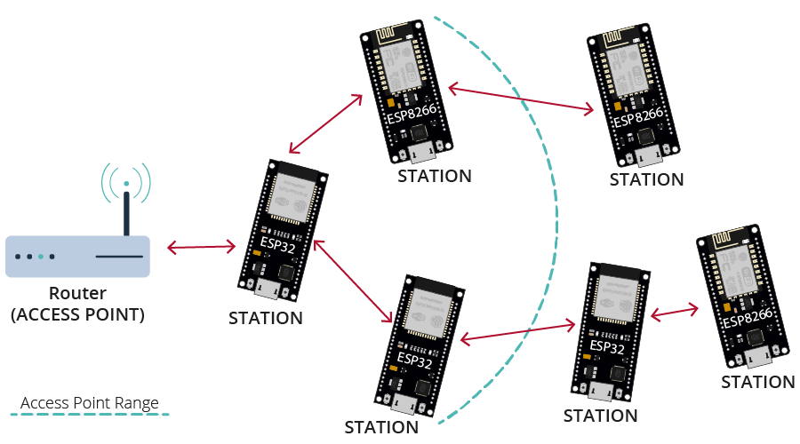
Solution Diagram

Slide 6
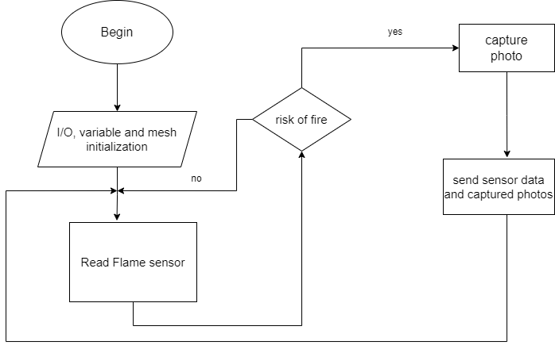
SW Flow Chart

Slide 7

Development Environments
Software:
Arduino IDE

Slide 8
Required Models
Ready to use:
Arduino libraries
painlessMesh
TaskScheduler
ArduinoJson
AsyncTCP
To be developed:
restAPI Server

Slide 9
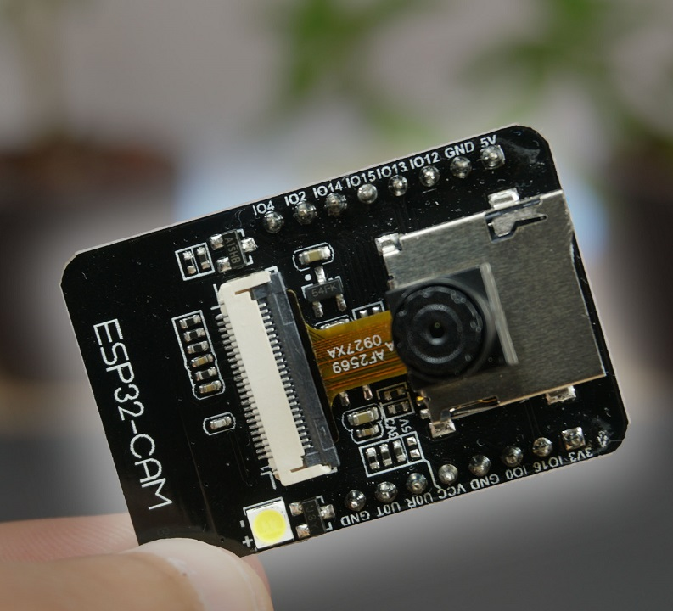
Proposed Components

Slide 10
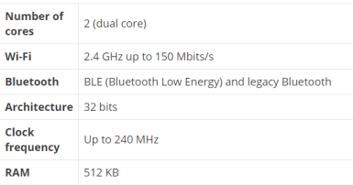
Processor
esp32 cam
Esp32 cam is dual core.
It has WI-FI, camera and Bluetooth built-in.
It runs 32 bit program.
The esp32 cam can be programmed using many different development environments. Code can be written in c or in MicroPython.

Slide 11
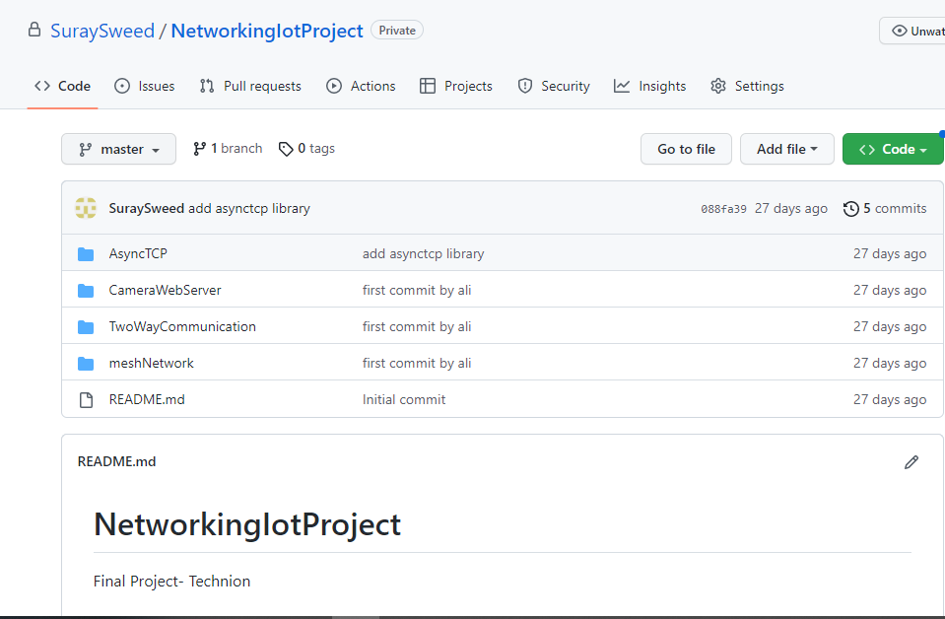

Project Management

Slide 12


Slide 13
Send images between esp’s
restAPI Server

